Slide 1
Purpose
Sprint ReVIEW: Why We’re here
To review the working product increment, gather stakeholder feedback, and adapt next steps based on what we learn. What Happens ✅ Team demonstrates completed, working functionality ✅ Stakeholders see real progress against the product vision ✅ Open discussion to validate direction and surface feedback What You Get 📌 Clear view of what’s done and usable 📌 Opportunity to influence priorities early 📌 Shared understanding of product status and next steps Outcomes 🔁 Feedback captured 🔁 Product Backlog updated or reprioritized as needed 🔁 Alignment on where the product goes next This is a collaborative working session—not a status report or approval gate.

Slide 2
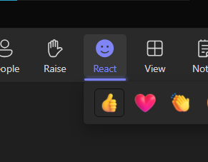
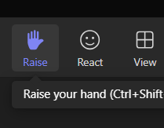
Sprint Review
Need your participation, but how?
You could type on the chat, no magic there.
Use the Reaction if you see something that you is worthy of your interaction but not that much as unmute or type something on the chat. For introverts, might be your choice.
Rise your virtual hand, we will try to put you in queue for talking as soon the spot is open.

Slide 3

Team Everest
Sprint 8 - 2026 Review

Slide 4
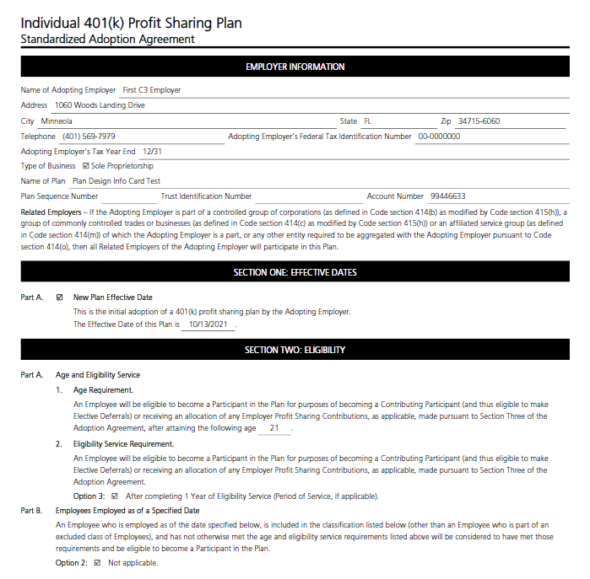
Product Vision
Streamlined, innovative software to ensure the efficient processing and delivery of compliant documents.

Slide 5
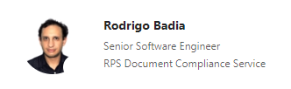
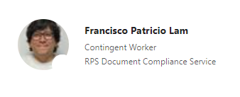
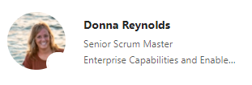


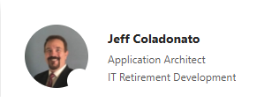
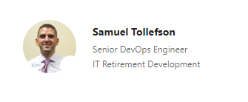

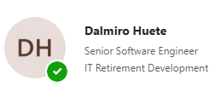
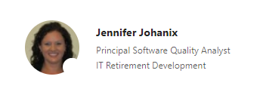
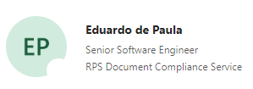





Team Everest Roster

Slide 6
Agenda
1
Sprint 8 – 2026 Overview
2
Demo
3
Sprint 9 - 2026 Highlights
4
Initiative Burn-Ups

Slide 7
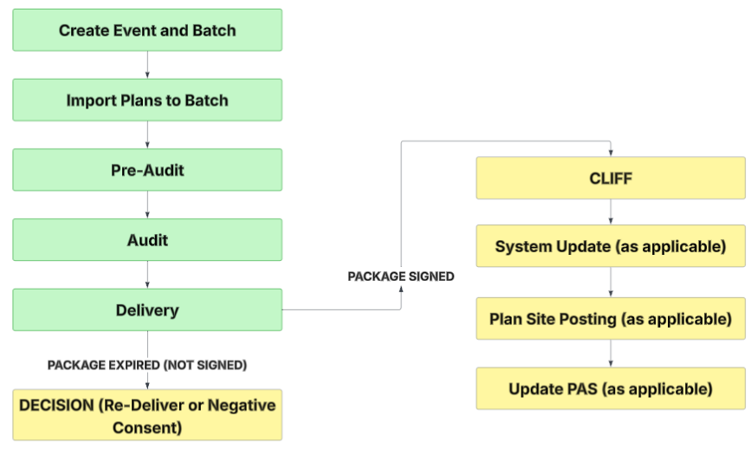
Mass Delivery & Tracking Tool

Slide 8

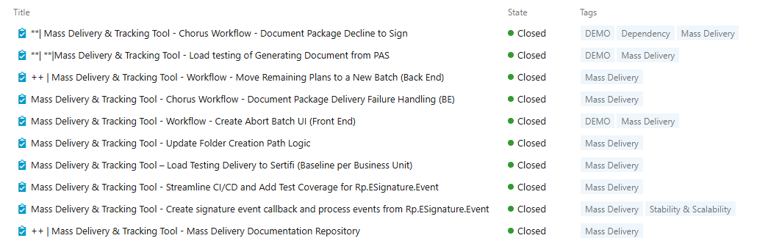
Team Everest Updates – Completed Work
MASS DELIVERY AND TRACKING TOOL
🏢 Internal 👥 Commercial Clients 🤝 External Plan Sponsor

Slide 9
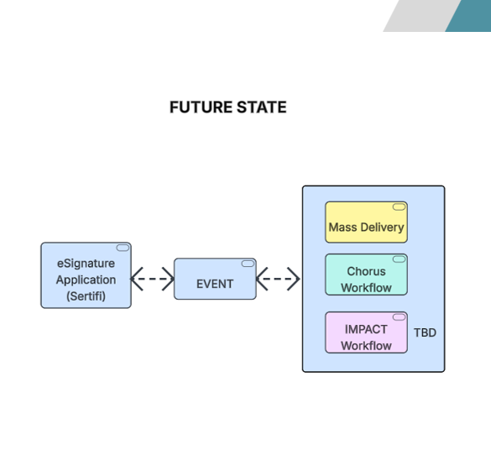
Team Everest Updates – Completed Work Value
MASS DELIVERY AND TRACKING TOOL
After packages have expired at the eSignature vendor, created the back-end process to allow a user to move these plans to a new batch.
Created the back-end process to handle when delivery to the eSignature vendor fails (undeliverable, inbox full).
Changed folder path naming to mirror how it is done today for Chorus or Impact workflow (Execution date and time).
Created the load testing for delivery for each business unit.
Created the CI/CD process for the new eSignature application and added integration testing.
Connected Mass Delivery and Tracking Tool workflow to the new eSignature application.
Leveraging AI, created document repository for technical and business flow.
DEMO
Handling when a client chooses to Decline to Sign when they review the package from the eSignature vendor.
Allow a user to abort a batch prior to delivery step.
Completed and documented load testing for the Document Generation step.
🏢 Internal 👥 Commercial Clients 🤝 External Plan Sponsor
Notes:
Continuous Integration / Continuous Deployment

Slide 10
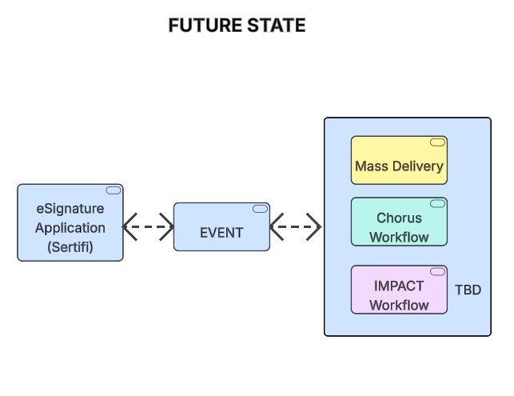

Slide 11
Team Everest Updates – Completed Work
INTERIM AMENDMENT
🏢 Internal 👥 Commercial Clients 🤝 External Plan Sponsor

Slide 12
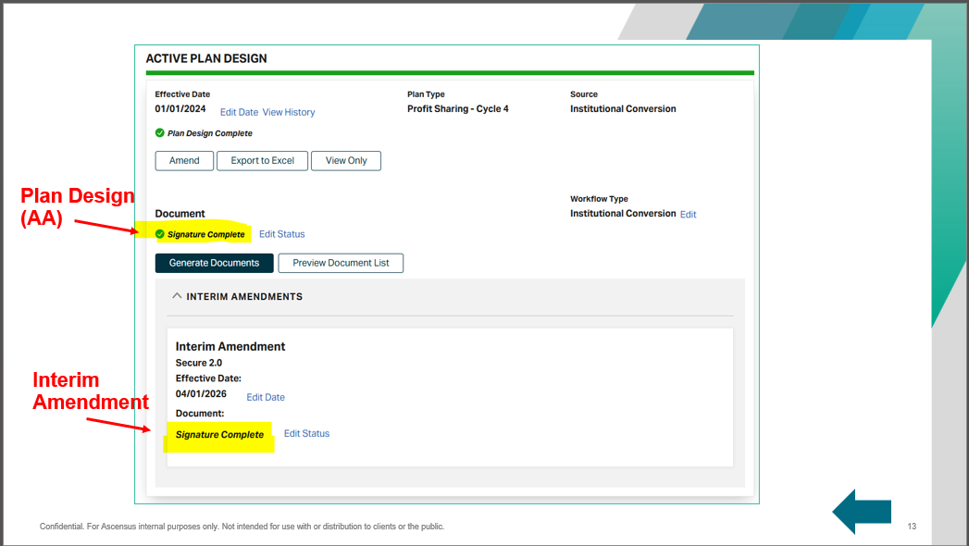
Team Everest Updates – Completed Work Value
INTERIM AMENDMENT
Completed update to Chorus workflow for determining which document status will require updating.
To be tested by business when we have the IMPACT workflow also updated.
If Template Name contains the words “Interim Amendment Only” THEN we will only update document status for Interim Amendment
If Template Name contains the words “Includes Interim Amendment” THEN we will update BOTH the document status for the Plan Design (AA) and Interim Amendment
If Template Name contains the words “Excludes Interim Amendment” THEN we will only update document status for the Plan Design (AA)
Completed a fix to ensure Amend/Edit button always appears regardless of Interim amendment document status.
Completed SECURE 2.0 Cycle 3 and PAS business acceptance testing!
🏢 Internal 👥 Commercial Clients 🤝 External Plan Sponsor

Slide 13
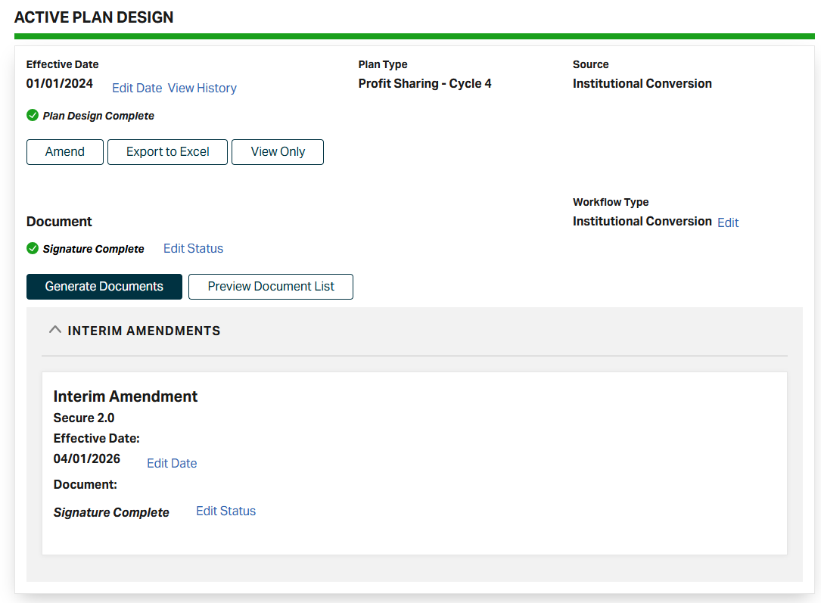




Plan Design (AA)
Interim Amendment
Notes:
Interim Amendment Only
Includes Interim Amendment
Excludes Interim Amendment

Slide 14
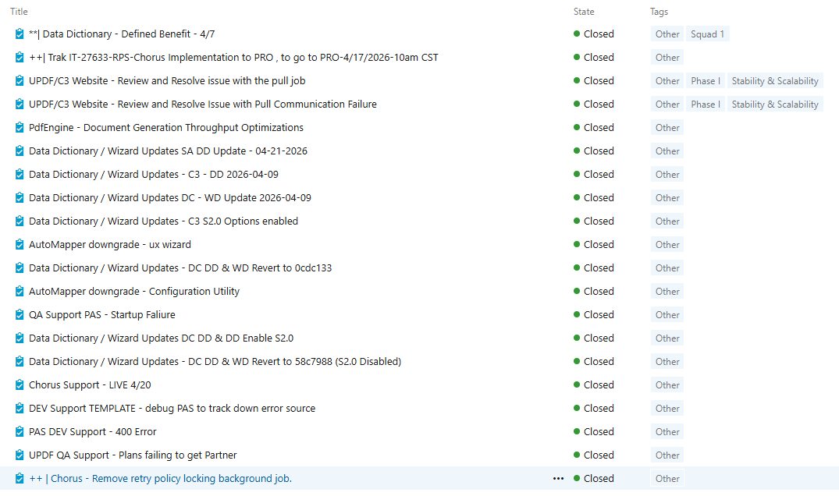
Team Everest Updates – Completed Work
MISCELLANEOUS

Slide 15
Team Everest Updates – Completed Work Value
MISCELLANEOUS
Several shuffling of Data Dictionaries and Wizards to ensure testing for SECURE 2.0.
In preparation for the Chorus roll to production last week, resolved a couple security concerns and corrected an issue with saw with our background process for when documents are generated.
Needed to adjust a utility we use for EIA as it is now requiring payment, needed to downgrade to a lower version.

Slide 16
Team Everest Sprint 8 - 2026 Goals
Mass Delivery & Tracking Tool
Handling Delivery Failure Done!
Handling Decline to Sign Done!
Backend process to handle moving remaining plans to a new batch Done!
Create UI for Abort Batch Done!
Interim Amendment
Small UX corrections Done!
Support business acceptance testing Done!

Slide 17
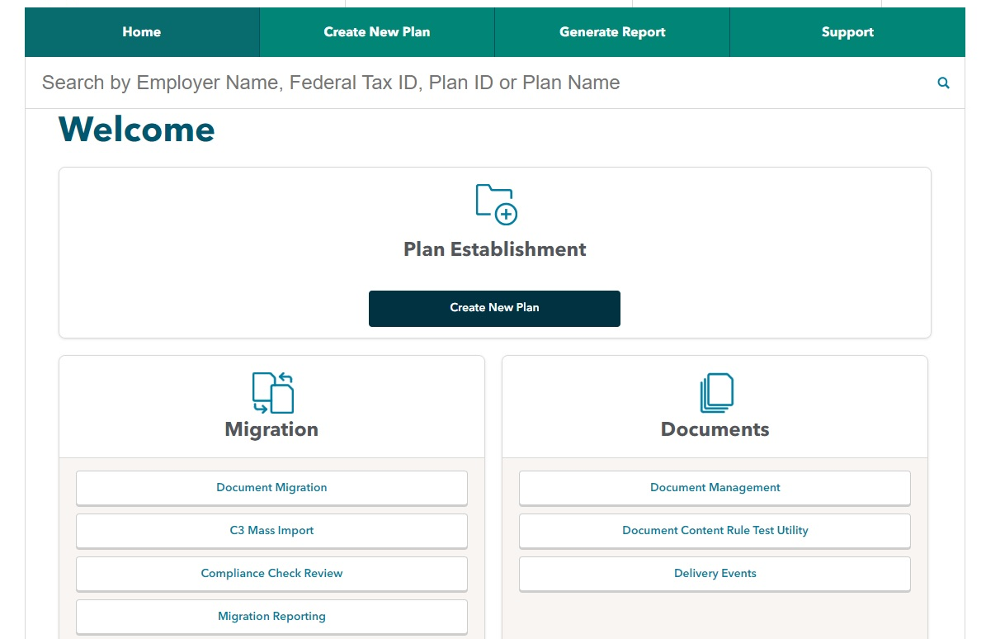
DEMO
Jenni Johanix
Eduardo de Paula
Andree Aguilar

Slide 18
Sprint 9 - 2026 Highlights
MASS DELIVERY AND TRACKING TOOL
Calculating Event Start and End Dates by Batch
Re-Delivery Workflow for Expired Document Packages (Move Remaining Plans to a New Batch)
Automating the InContact Call Routing Process
Building the Client Status Report
🏢 Internal 👥 Commercial Clients 🤝 External Plan Sponsor

Slide 19
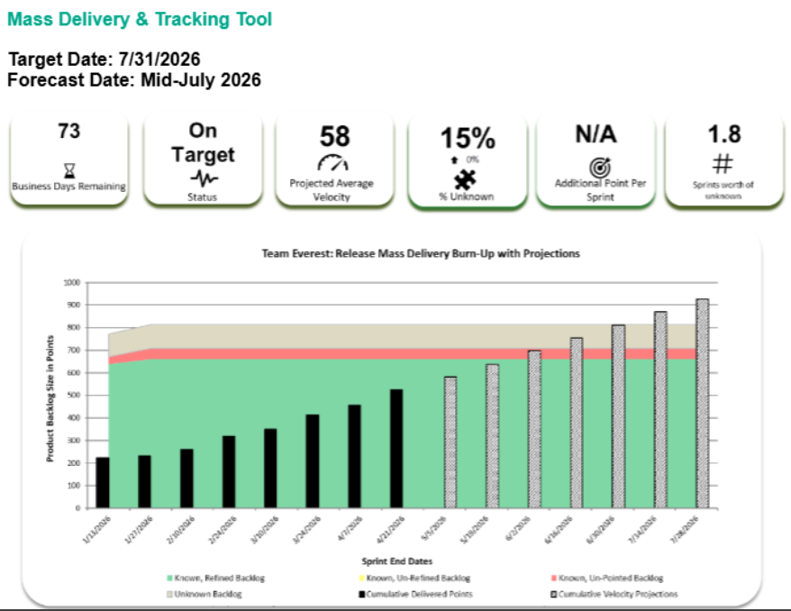

Slide 20
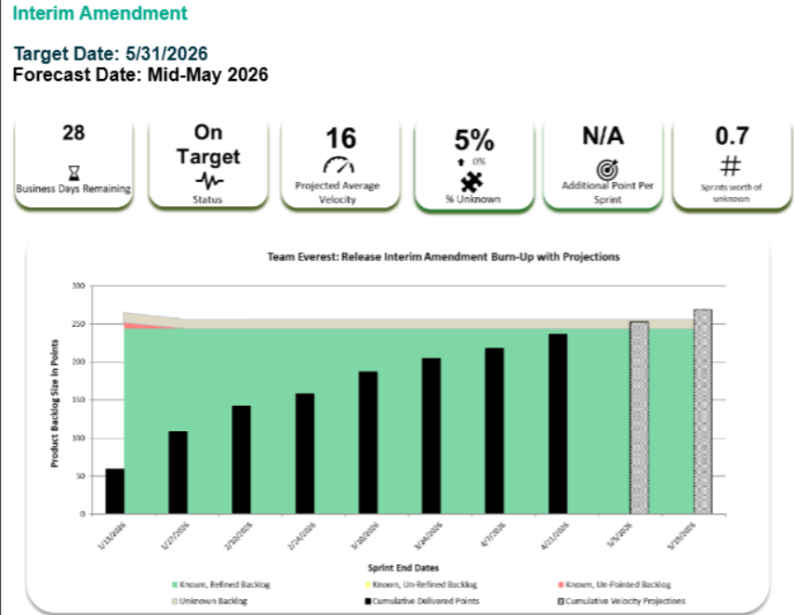

Slide 21
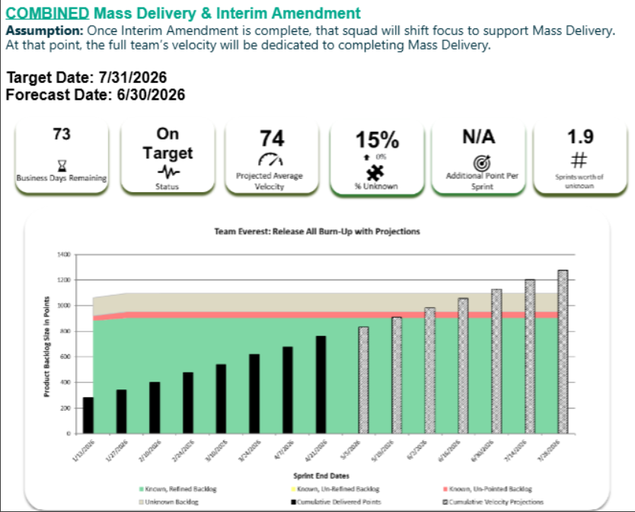

Slide 22
Questions?

